Slide 1
WELCOME
.

Slide 2
PREREQUISITES OF DEVELOPMENT
INTRODUCTION
Prerequisites of development refers to positive and appropriate environment as prior condition for development .
There are many importance prerequisites of development like health , public participation , entrepreneurship , peace etc .
Literacy is also one of the important prerequisites of development .

Slide 3
INTRODUCTION TO LITERACY
Literacy is the ability to …...
Read
Write
Use number
Make decision
Solve problem
Express ideas and opinions

Slide 4
IMPORTANCE OF LITERACY
It helps to eradication problems of nutrition and health .
It reduces poverty and inequality .
It helps in economic development and community well-being .
it is essential to developing a strong sense of well-being and citizenship .

Slide 5
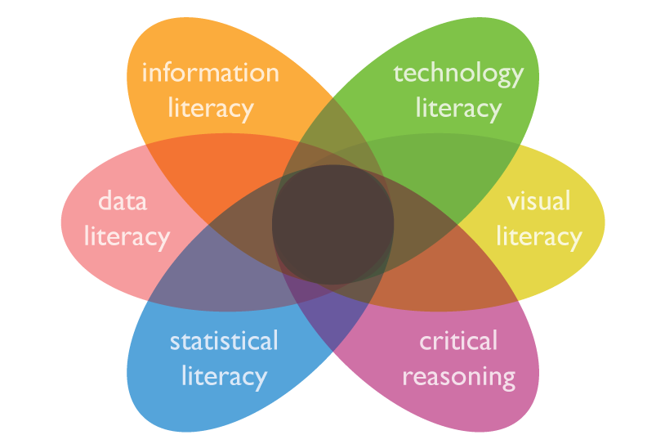
TYPES OF LITERACY

Slide 6
ADVANTAGE OF LITERACY
We can easily communicate certain information in certain conditions .
We don’t need to have good memory we can just reply on reading/writing .
We can be able to make our own decision and gives the concept of freedom to us .

Slide 7
DISADVANTAGE OF LITERACY
Consumes many resource ( every year more than 4 billon trees or 35% of trees are used for producing paper)
Doesn’t really solve all the problem ( Russia , Ukraine , Kazakhstan , Kyrgyzstan , Trinidad and Tobago have extremely high literacy rates and also very high homicide rates )

Slide 8
THANK YOU

